Slide 1

Edesia
Sprint Retrospective
Team Blue
Adam Bowers | Daniel Wingo | Stephen Bennett | Jonathan Holley
Github: aLotofAdam | 81wingo | stephenbennett2 | mccauley747
UNCG: ajbower3 | dtwingo | scbenne3 | jbholley

Slide 2
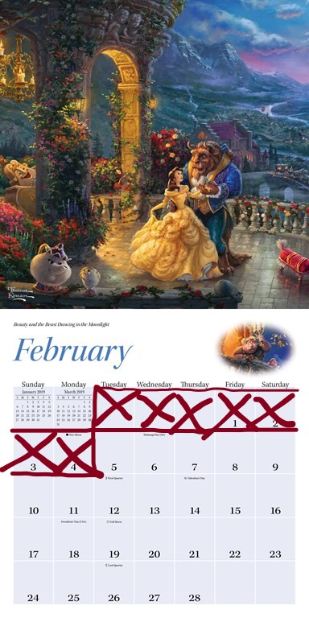

Last Sprint
Created Issues in Zenhub
Researched Softwares
Finished Project Definition & Requirements Specification
Prepared Progress Report 1 and Oral Presentation

Slide 3
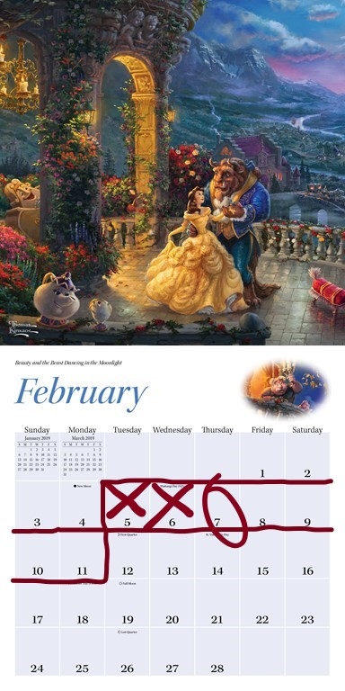
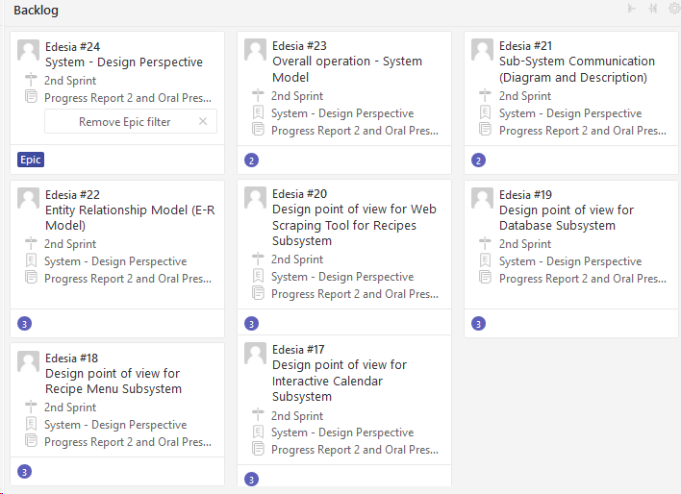
Current Sprint
Optical Character Recognition (OCR)
Detailed Features
System - Design Perspective

Slide 4
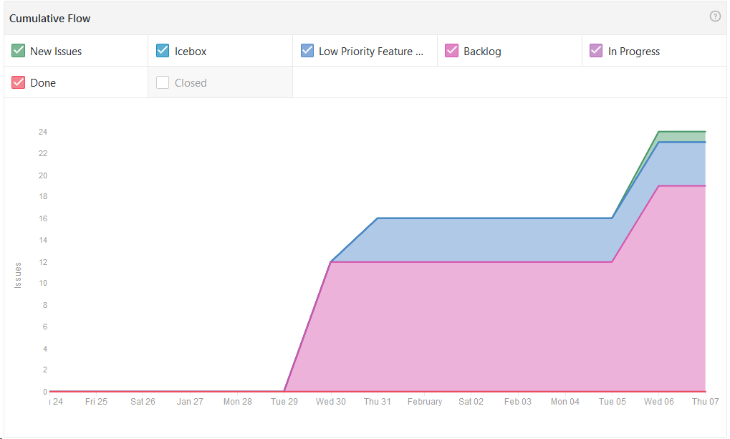
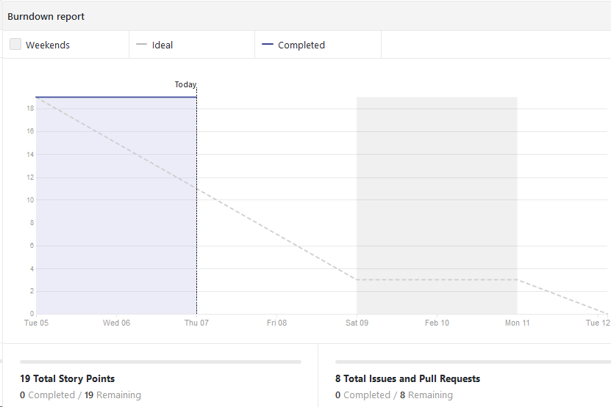
Cumulative Flow & Burndown Chart

Slide 5
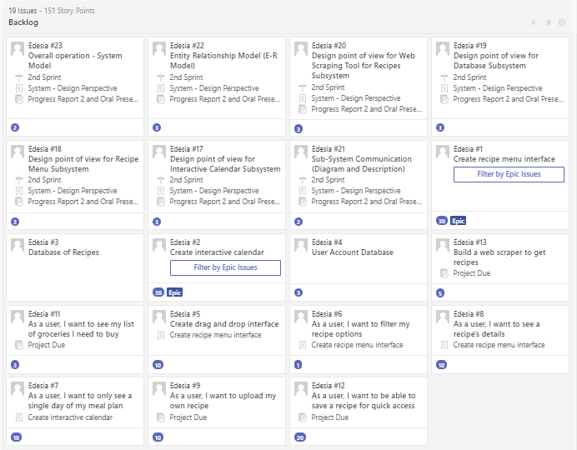
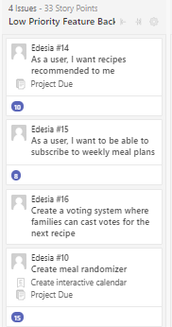
Product Backlog

Slide 6
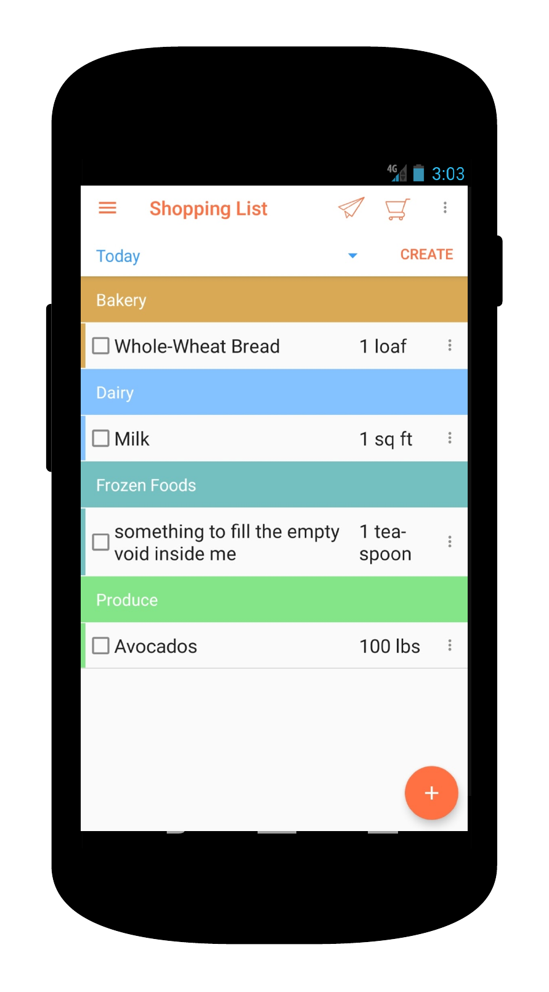
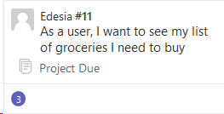
Automated Shopping List
Curate shopping list from meal plan
Categorized items
Scaleable serving size
Check items off list as you shop

Slide 7
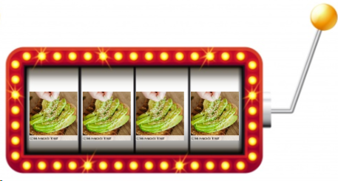
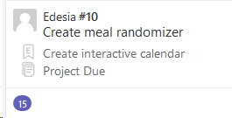
Meal Plan Shuffle
Randomizes Meal Plan
For indecisive users
“Try something new” or “User approved”
Slot machine interface

Slide 8
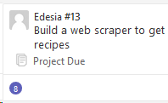
Web Scraper to get Recipes
Python
script will be ran once a week on 3 different recipe websites
The script will populate the database with information( protein type, ingredients,time to cook, directions, nutrition facts and picture)

Slide 9
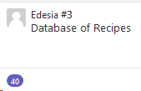
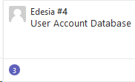
Database Recipes and Users
SQLite
Recipes will store ( protein type, ingredients, time to cook, directions, nutrition facts and picture)
Users will store basic user information

Slide 10
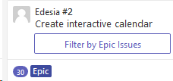
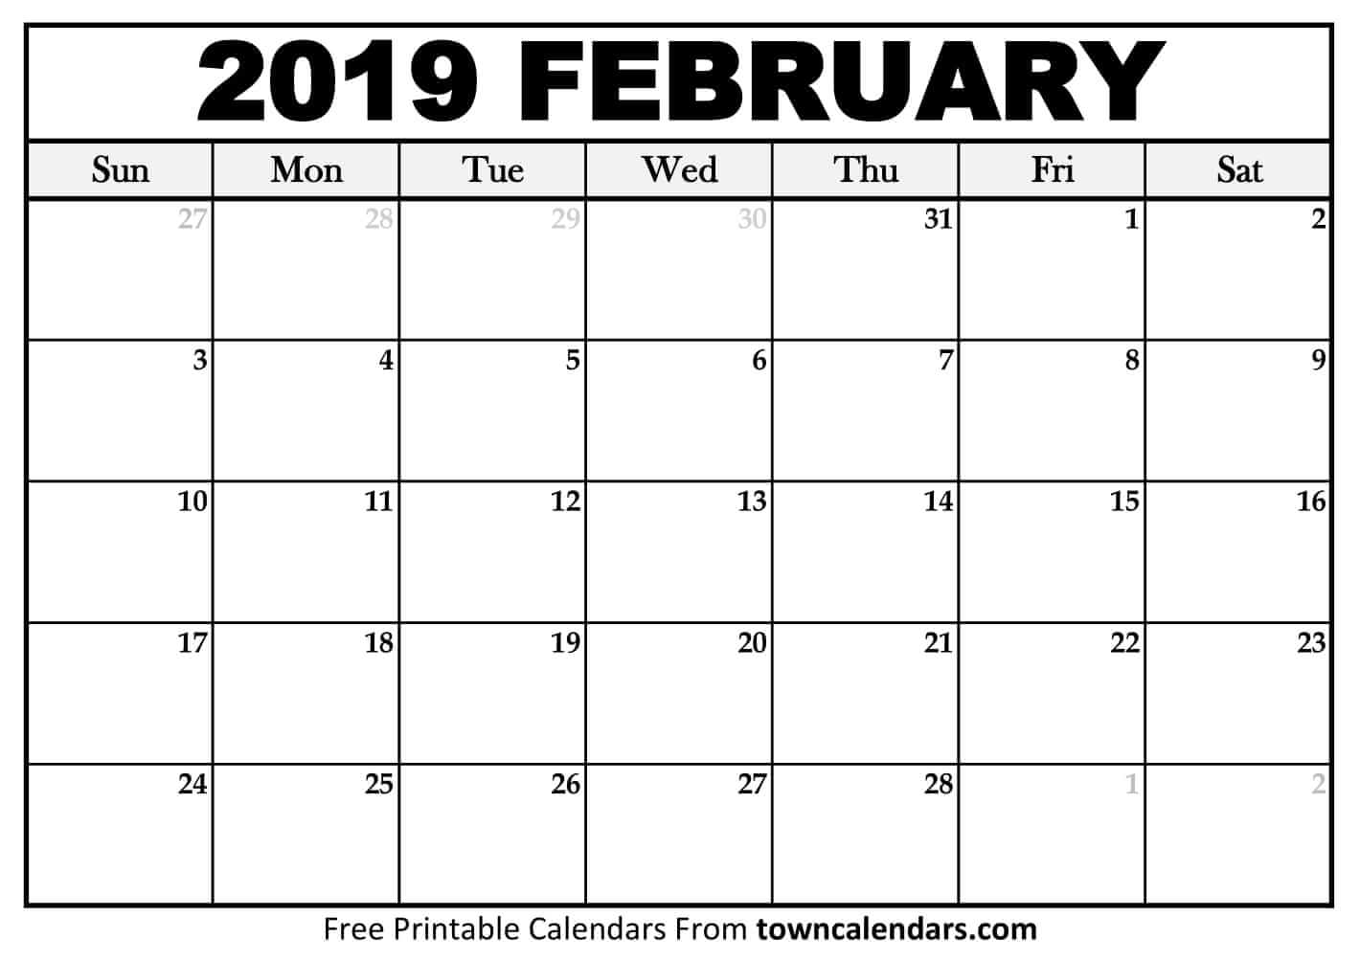
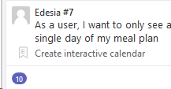
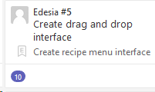
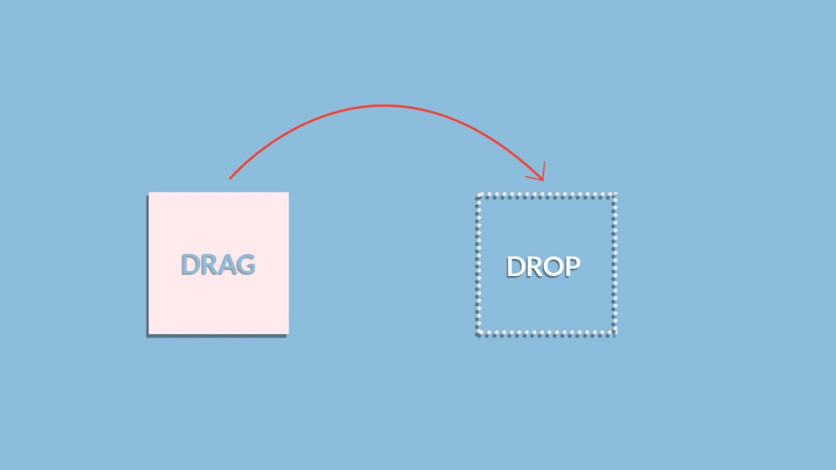
Drag-and-Drop Interface/Calendar
The interface will be made using Java.
The user will have a calendar that is weekly or daily.
The user will then choose the meals from a slide out list.
The user can then drag the recipes to the slots for Breakfast, Lunch, or Dinner.
A grocery list will be generated from the meals that are chosen.

Slide 11
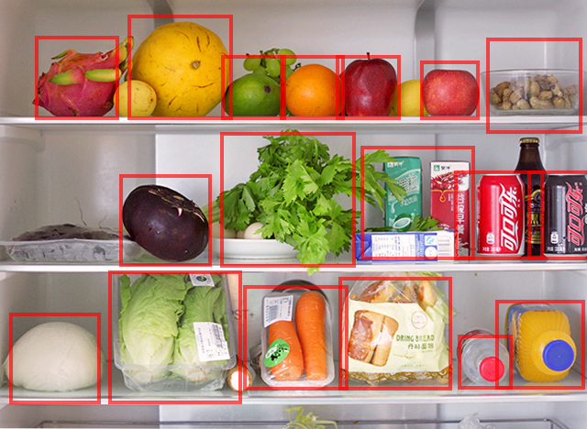

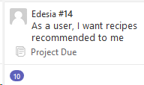
Recipe search for ingredients on hand
Based on user’s current stock of ingredients.
Different methods for searching (undecided)
Photos, receipts, barcode, manual input, rolling inventory
Tesseract, Java OCR(Asprise), OCR Space, and Google Vision

Slide 12

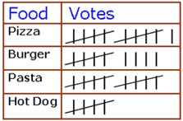

User group voting system (We’ll see)
Allow users to create groups
One user presents options for others to vote on
Returns tally

